Slide 1

Voltmeter Clock
A Project by Sam Scevenels

Slide 2
Content
-Introduction to the device
What is it?
What does it do?
Why did you choose to build this
-How does it work?
-Product Price
-Encountered problems
Drawing the scheme
Ordering the components
Designing and making of the case
Designing the PCB Layout

Slide 3
Introduction to the device. What is it?
A Clock for electronics enthusiasts
Easy to build

Slide 4
Introduction to the device. What does it do?
It tells you the time

Slide 5
Introduction to the device. Why did you choose to build this?
Found the idea on hackaday
Original idea → nixie clock
Volmeterclock was more interesting

Slide 6
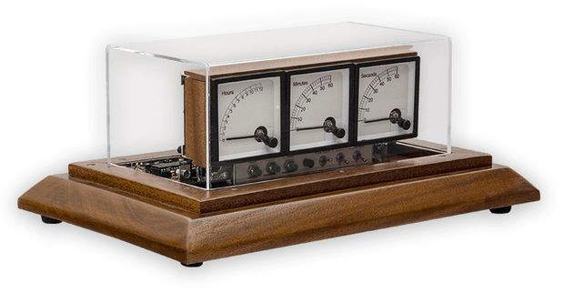
How does it work?
3 Analog voltmeters → Driven by microcontroller
Uses PWM → different ranges of meters
Settings:
Adjust the Scale
Ticking Seconds → relay
Smooth Seconds
Sync
Display

Slide 7
Product Price
My total Price consist of 4 Suppliers
-LCLC €6,52 res./cap./IC’s
-Gotron €45,74 Buttons/switches/LED’s/Trans.
-RS Components €84,83 Voltmeters/Transfo/Osc.
-JLCPCB €41,51 PCB
Total Price: €178,6

Slide 8
Encountered problems. Drawing the scheme
1st: Unfamiliar with program
2nd: Unfamiliar with drawing Schemes → Redid whole thing
3rd: Assigning footprints

Slide 9
Encountered problems. Ordering the products
1st: finding voltmeters
2nd: Corona Outbreak
3rd: Rs Components → Need of a BTW Number

Slide 10
Encountered problems. Designing and making of the case
No problems Encountered
Sketches → AutoCAD
Flawless

Slide 11
Encountered problems. Designing the PCB layout
1st: Unfamiliar
2nd: Completing the Gerber
3rd: Fixing the board outline

Slide 12
FIN

